Slide 1
Robert Goodman, Ed.D
NJ Center for Teaching and Learning
&
Bergen County Technical HS - Teterboro
bgoodman33@gmail.com
www.njctl.org

Slide 2

New Jersey
Center for Teaching and Learning
Empowering Teachers …Leading Change
www.njctl.org
Notes:
A Foundation created and initially funded by the NJEA in 2006
Its mission is to empower teachers to lead change so that all children have access to a high quality education
One aspect of that mission is to work with teachers to spread and improve successful programs so that all students benefit

Slide 3
Progressive Science Initiative (PSI) & Progressive Mathematics Initiative (PMI)
PSI developed to teach HS science
PSI then used to create HS science teachers
PMI uses PSI Methods to teach K-12 math
PMI will be used to create K-12 math teachers

Slide 4
Progressive Science Initiative (PSI) & Progressive Mathematics Initiative (PMI)
Developed in 1 NJ school: 1999 - present
Extended to 50+ NJ schools: 2007 – present
Extended to Argentina: 2010 - present
Extended to RI: 2011

Slide 5
AP Performance and International Competitiveness
1995 TIMSS Results - Physics

Slide 6
AP Exams as a Goal
Provides a standard metric
Recognized by K-12, colleges & universities, students and parents
Correlated to international competitiveness
Gives students access to top colleges & universities, plus scholarships

Slide 7
AP Science Exams Taken
(2010 – Bergen Tech vs. Normed State)

Slide 8
AP Science Exams Passed
(2010 – Bergen Tech vs. Normed State)

Slide 9
PSI-PMI Paradigm Shift
From teaching, to learning

Slide 10
PSI-PMI Paradigm Shift
From teacher-centered, to student-centered

Slide 11
PSI-PMI Paradigm Shift
From passive learning, to active learning

Slide 12
PSI-PMI Paradigm Shift
From teacher isolation, to teacher collaboration

Slide 13
PSI-PMI Paradigm Shift
From schools and classrooms being private and hidden, to being public and visible

Slide 14
PSI-PMI Paradigm Shift
From static analog textbooks, to continuously improving digital content

Slide 15
PSI-PMI Paradigm Shift
From teachers being responsible for only their students, to being responsible for all students

Slide 16
PSI-PMI Paradigm Shift
“There is a shift from teaching to learning, from working alone to collaboration, from passive to active learning, from analog to digital, from teaching a class to sharing authority for educating all the kids at a school, or beyond.”
Arthur Levine, President
Woodrow Wilson National Fellowship Foundation

Slide 17
PSI-PMI Methods
Curriculum
Pedagogy
Formative Assessment
Summative Assessment and Grading
Technology
Face-to-Face and Virtual PLCs

Slide 18
Curriculum
PSI Course Sequence: Grades 9 – 12

Slide 19
Curriculum
PSI Course Sequence: Minimal Version

Slide 20
Curriculum
Traditional Course Sequence

Slide 21
Pedagogy
Social Constructivism
Plus
Direct Instruction

Slide 22
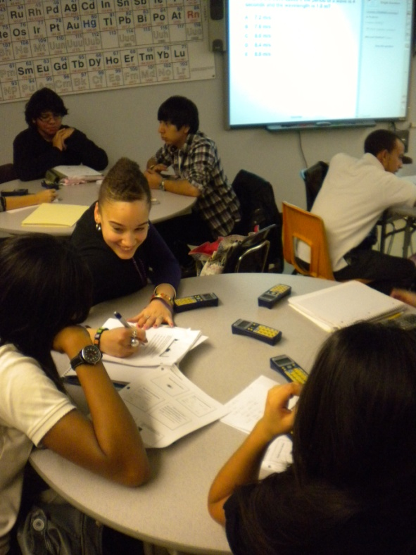
Pedagogy
Social Constructivism
  Round Tables
  Group Problem Solving
  Heterogeneous setting

Slide 23
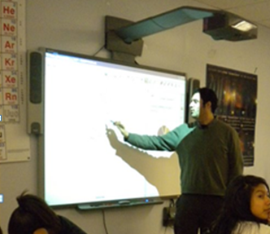
Pedagogy
Direct Instruction
  Interactive White Board (IWB) Notebook presentation
  Student Response Formative Assessment
  Teacher as part of social group

Slide 24
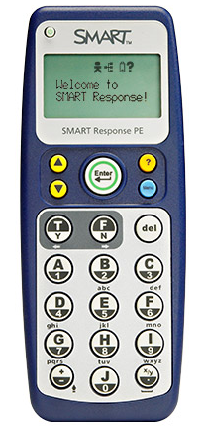
Formative Assessment
Student Responders
Anonymous student polling during class to guide instruction

Slide 25
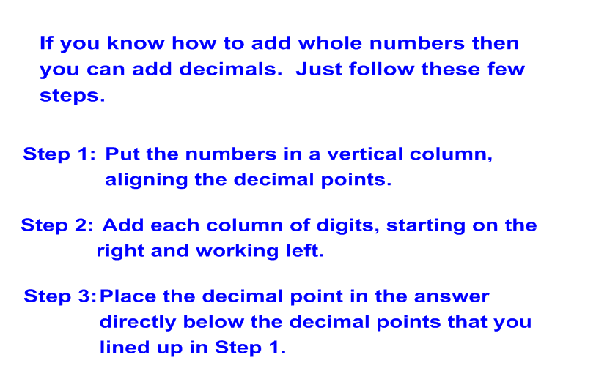
Direct Instruction
Direct Instruction: Adding Decimals

Slide 26
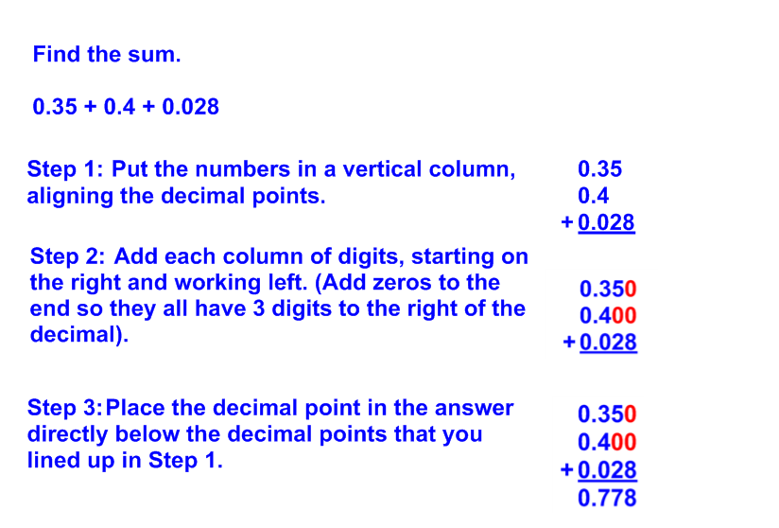
Direct Instruction
Example: Adding Decimals

Slide 27
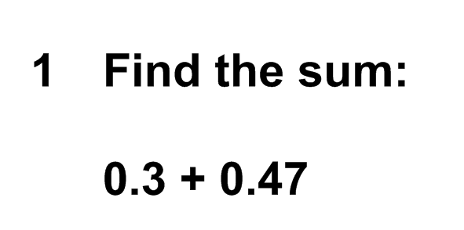
Formative Assessment

Slide 28
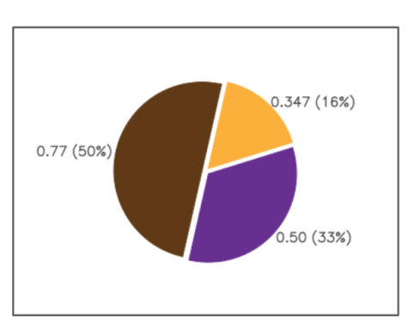
Formative Assessment

Slide 29
Summative Assessment
Grades based only on what students know and can do – Tests, quizzes and labs
Retakes for all assessments
Grades are not subjective
Correlated to End of Course Tests
  (APs, EOC Algebra I, Common Core, etc.)

Slide 30
Implementing Beyond Teterboro
Digital technology makes it possible to share PSI with other schools
Implementing PSI requires physics, chemistry & biology teachers
However, there is a shortage of physics and chemistry teachers

Slide 31
New Jersey Legislature Passes Pilot Certification Bill
Spring, 2009
Authorizes pilot programs to create new science and mathematics teachers
Opens the pathway to spreading PSI by creating new physics and chemistry teachers

Slide 32
Creating Science Teachers
PSI has shown “all students can learn science”.
We believe “all teachers can learn science”
PSI teaches science to skilled teachers.
The goal is to get the best teachers to become the best science teachers:
“Teaching is hard; science is easy”

Slide 33
NJCTL - Kean
Endorsement Program
Teachers are taught the science content and how to teach it
Teachers are provisionally authorized to teach a first level PSI course
Teachers take advanced courses while teaching the first course

Slide 34
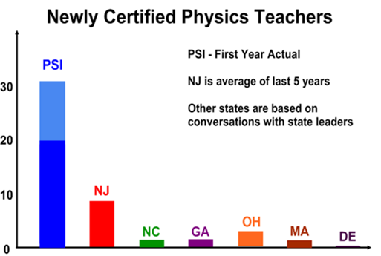
NJCTL Creates Science Teachers
Notes:
Significant continual improvement in quantitative measures: AP exams taken; AP exams passed; state tests passed; and SAT subject test scores
High levels of student interest in science and math based on elective choices and college majors
High student and teacher morale
An ability to “grow its own” great teachers on an ongoing basis along with low turnover of current teachers

Slide 35
New Teachers – June 2011
60 additional teachers – Chemistry and Physics
6 school districts
35 Schools: 21 current + 14 additional
Taught about 4000 students physics or chemistry in 2010-11
Notes:
Significant continual improvement in quantitative measures: AP exams taken; AP exams passed; state tests passed; and SAT subject test scores
High levels of student interest in science and math based on elective choices and college majors
High student and teacher morale
An ability to “grow its own” great teachers on an ongoing basis along with low turnover of current teachers

Slide 36
Provides Students Access to
Rigorous Courses
New PSI Physics Teachers:
  Taught Physics to 1200 urban students last year who wouldn’t have had access otherwise
  Are teaching more than 7000 students this year
  1/3 of students taught last year requested to take AP Physics B the this year, along with Chemistry

Slide 37
Newark Physics Teachers
(PSI began in 09-10)

Slide 38
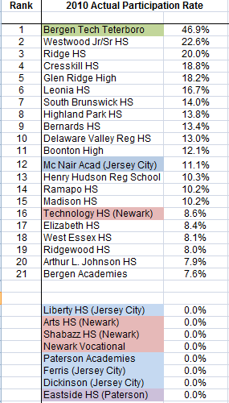
AP Physics B Participation Rates

Slide 39
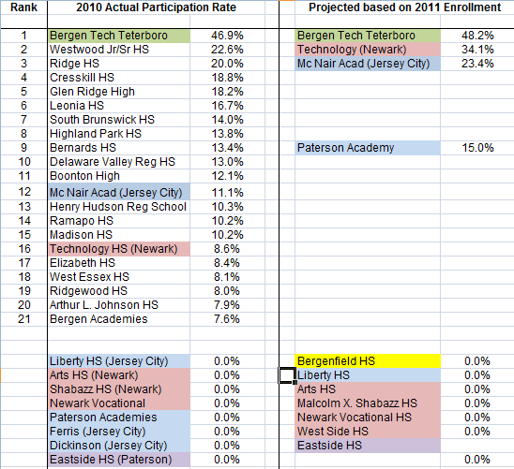
AP Physics B Participation Rates

Slide 40
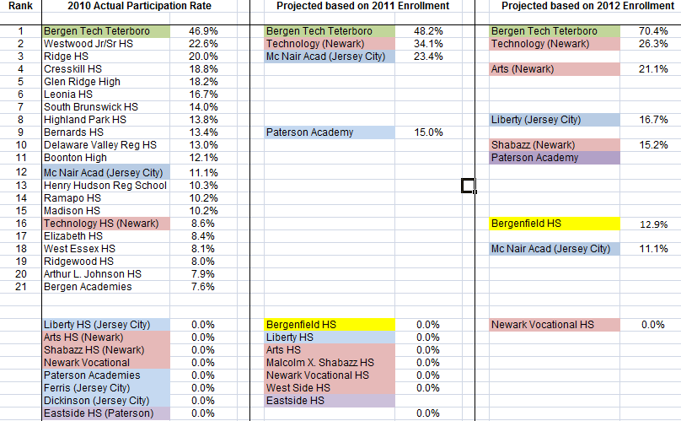
AP Physics B Participation Rates

Slide 41
Implementing in Argentina
Argentina Partner – Universidad La Punta (ULP) in San Luis, Argentina
Translating materials to Spanish, posted on www.njctl.org for the free use of all
Algebra Based Physics complete, Mathematics has begun

Slide 42
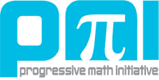
The Progressive Mathematics Initiative (PMI)

Slide 43
The Progressive Mathematics Initiative (PMI)
PSI methods were first used to develop two courses: Pre-Algebra and Algebra I
Piloted last year with positive results
Now being taught in more than a dozen NJ schools, and being extended to RI and VT

Slide 44
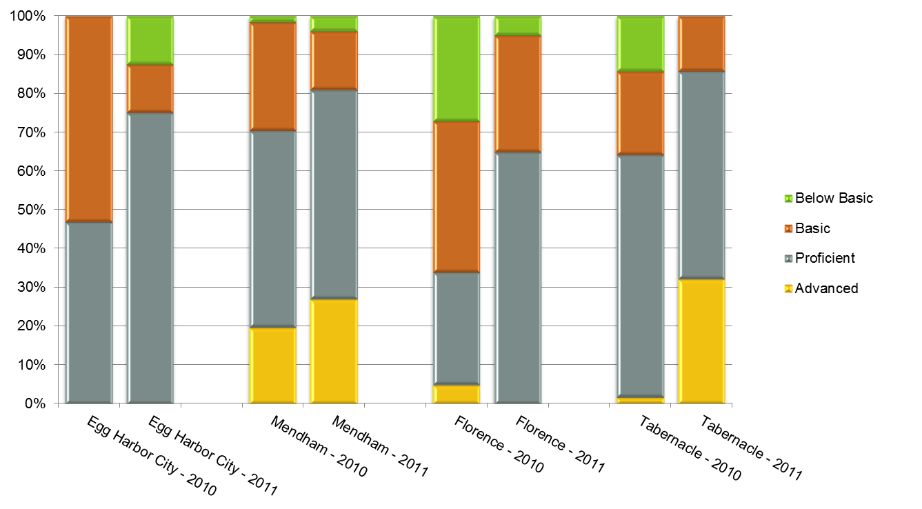
Algebra I APD EOC Test Results
Students who took Algebra I course

Slide 45
Algebra I ADP EOC Test Results
Percentage of students in school who took Algebra I

Slide 46
The Progressive Mathematics Initiative (PMI)
College Algebra piloted at Kean University
Used with students who had failed the course at least once, often multiple times
Better results on common assessments than sections with students who had not previously failed

Slide 47
The Progressive Mathematics Initiative (PMI)
High School mathematics almost completed; being piloted now
AP Calculus AB
Pre-Calculus
Algebra II
Geometry
Algebra I

Slide 48
The Progressive Mathematics Initiative (PMI)
Common Core aligned K-8 Mathematics
Being completed in time to be piloted this year
Year long plans and unit plans are posted for each grade
Early part of the year’s content is complete

Slide 49
Common Core Mathematics
Common Core is becoming the standard in 43 states
Current textbooks are not aligned to Common Core; they need to be replaced
But, textbooks themselves are becoming obsolete; districts don’t want to buy new ones
Free, highly effective, Common Core aligned course materials are critically important

Slide 50
PMI
Common Core Mathematics
PMI has already launched Common Core K-8 courses
Algebra I is currently aligned with the ADP Algebra I assessment
All high school courses will be Common Core aligned for next fall, when they are needed

Slide 51
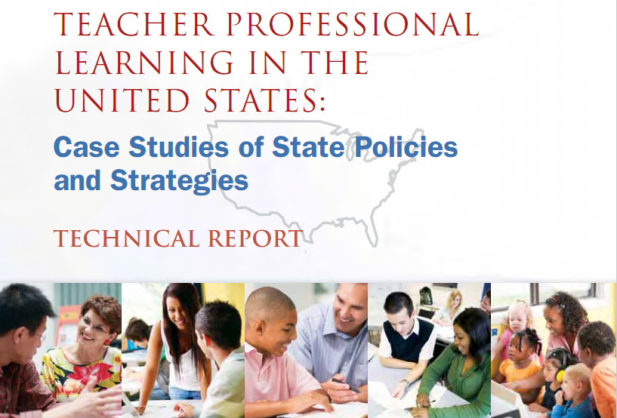
Learning Forward – National Report

Slide 52
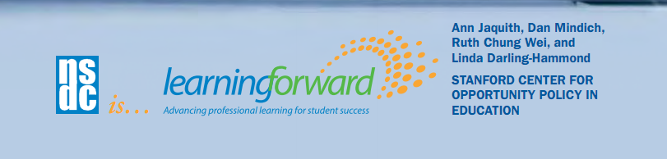
Learning Forward – National Report
“The New Jersey Center for Teaching and Learning (NJCTL) has been doing groundbreaking professional development work in math and science instruction as well…using the innovative curriculum of 2006 New Jersey Teacher of the Year Robert Goodman…to create the Progressive Science Initiative….”

Slide 53

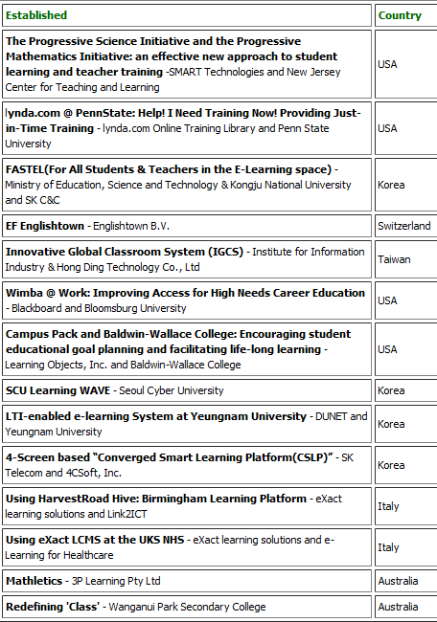

2011 IMS
Learning Impact Award
The Progressive Science Initiative and the Progressive Mathematics Initiative: an effective new approach to student learning and teacher training – SMART Technologies and New Jersey Center for Teaching and Learning

Slide 54
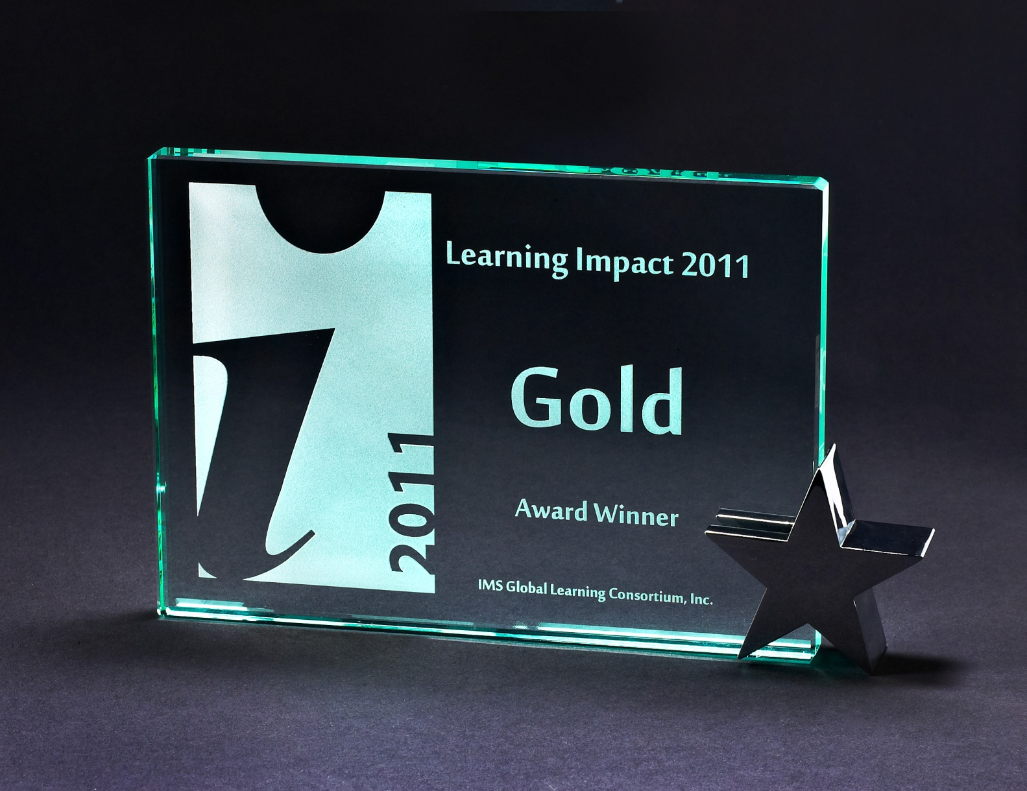
Gold Winner – 2011 IMS
Learning Impact Award

Slide 55
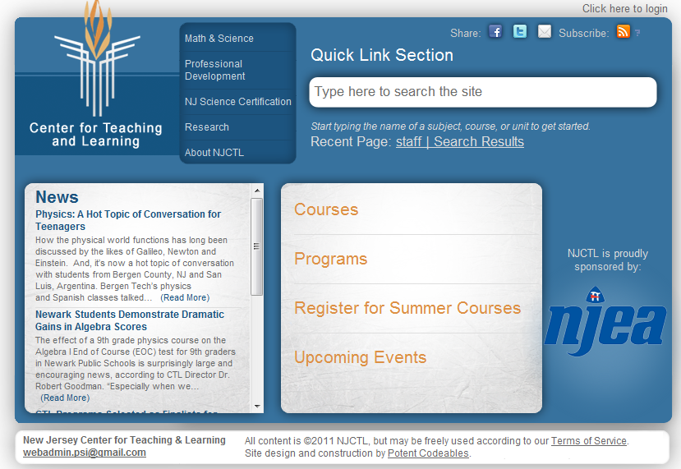
www.njctl.org

Slide 56
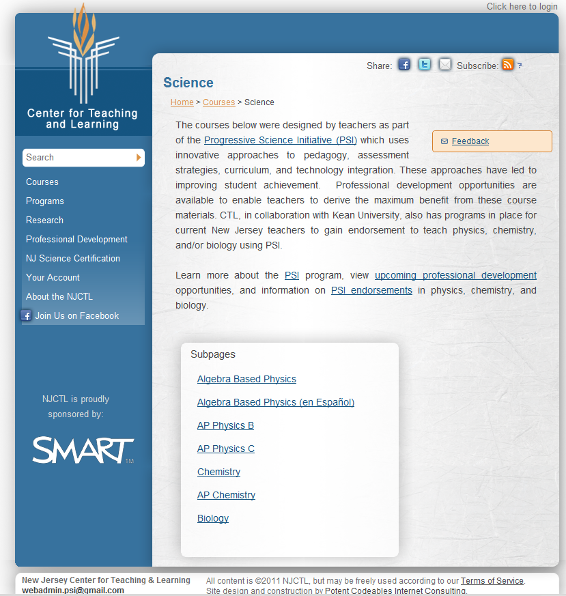
www.njctl.org

Slide 57
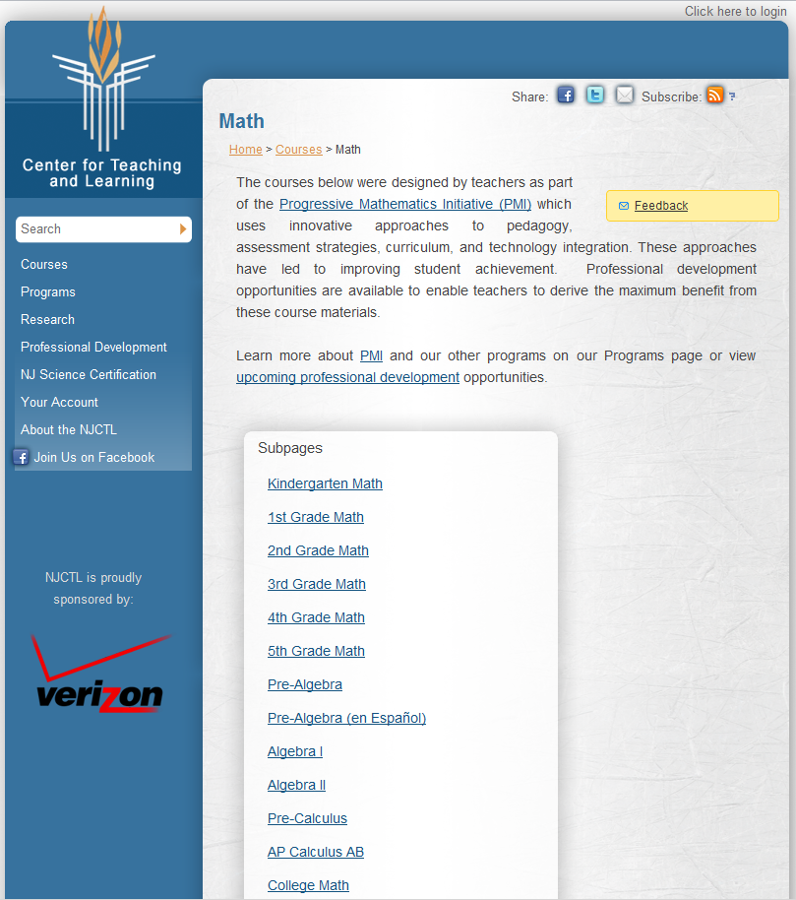
www.njctl.org

Slide 58
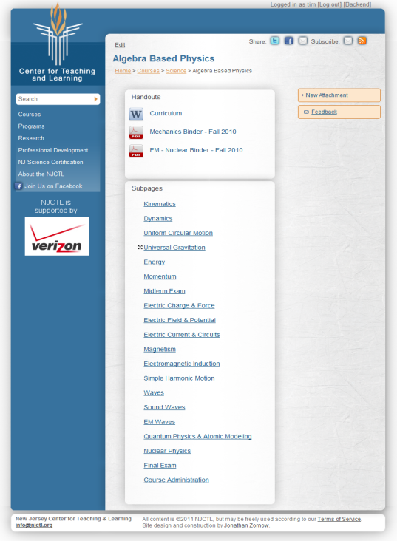
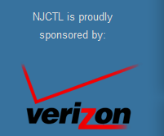
www.njctl.org

Slide 59
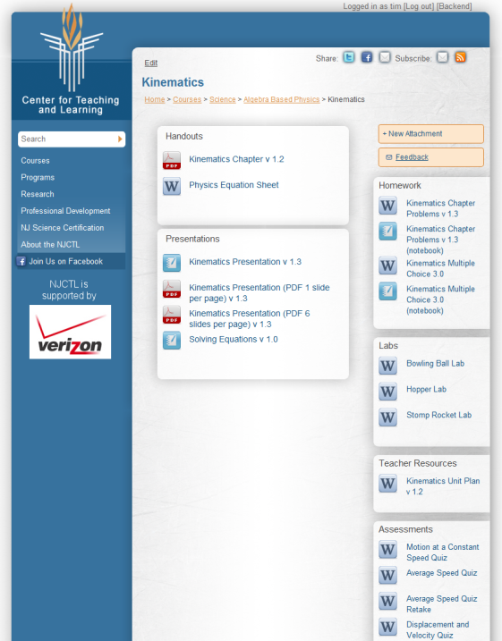

www.njctl.org

Slide 60
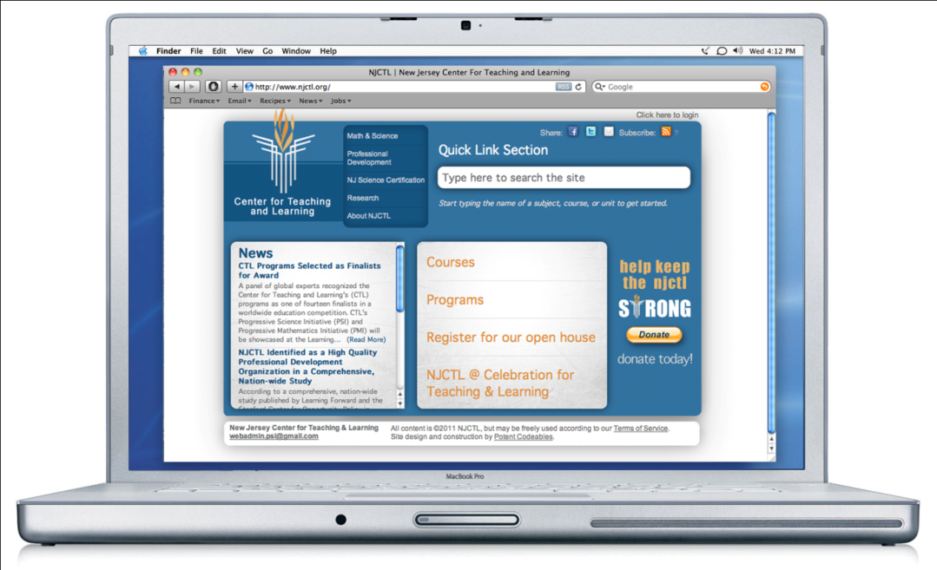
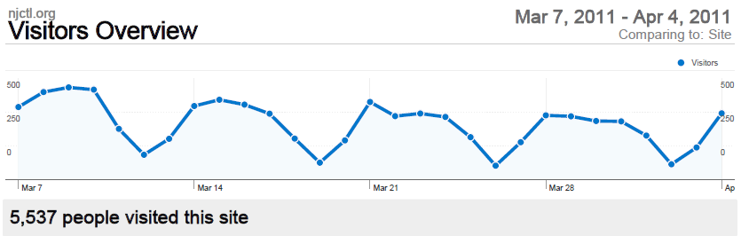
www.njctl.org
All course materials are posted
Open Source Approach - Free access to all
50,000+ hits per month
5000+ unique visitors per month, and growing (worldwide)

Slide 61
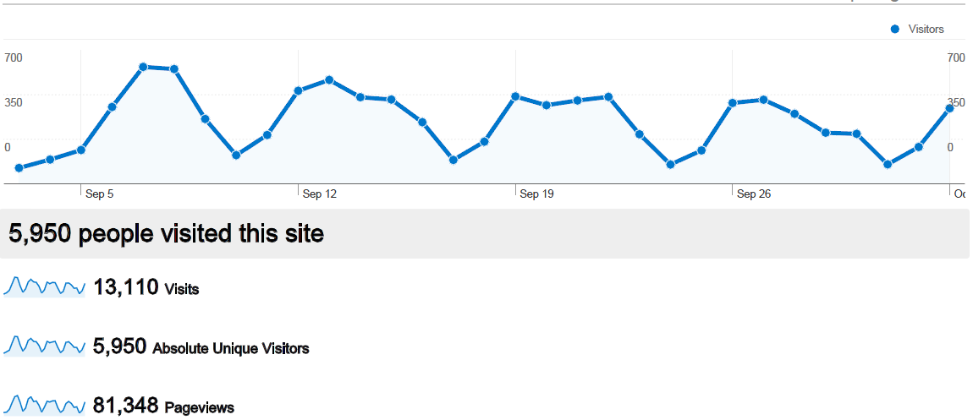
September Web Site Analytics

Slide 62
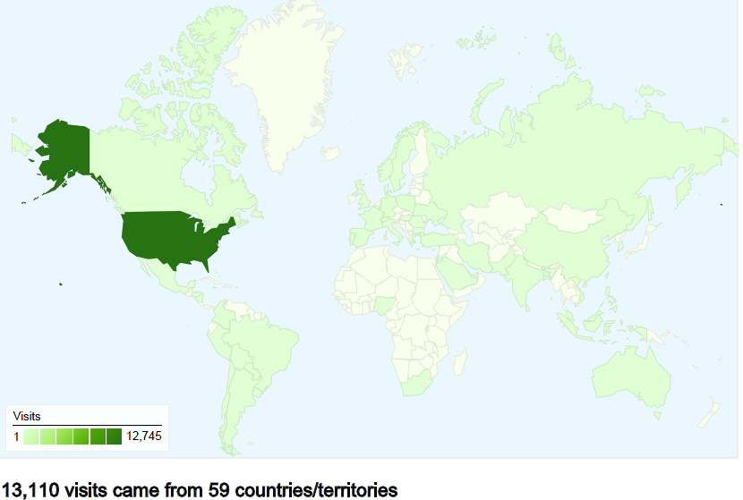
September Web Site Analytics

Slide 63
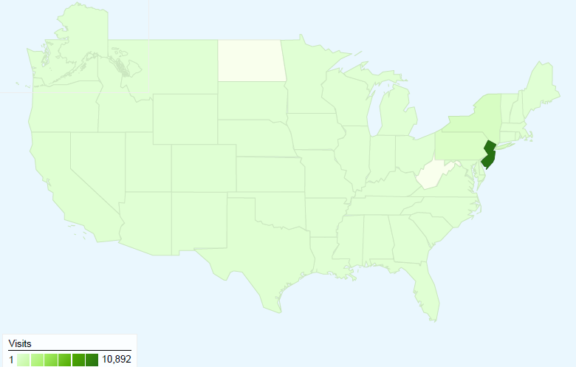
September Web Site Analytics

Slide 64
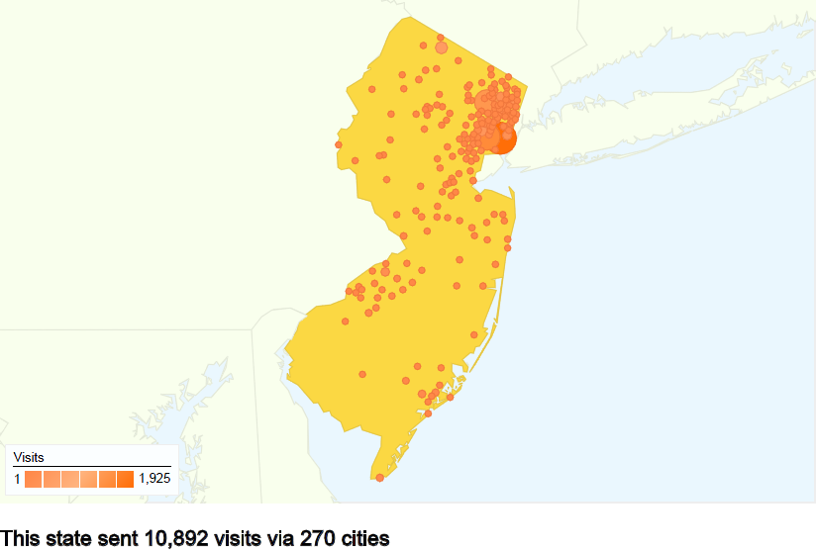
September Web Site Analytics

Slide 65
Students and Teachers
Learning Communities
Now, thousands of students are taking the same courses, this could scale up to hundreds of thousands
Now, hundreds of teachers are teaching the same courses, this could scale up to tens of thousands
This provides a foundation for large scale global collaboration through internet connections

Slide 66
New Jersey
Center for Teaching and Learning
Empowering Teachers …Leading Change
www.njctl.org
Notes:
A Foundation created and initially funded by the NJEA in 2006
Its mission is to empower teachers to lead change so that all children have access to a high quality education
One aspect of that mission is to work with teachers to spread and improve successful programs so that all students benefit

