Slide 1
Robert Goodman, Ed.D
NJ Center for Teaching and Learning
&
Bergen County Technical HS - Teterboro
bgoodman33@gmail.com
www.njctl.org

Slide 2

New Jersey
Center for Teaching and Learning
Empowering Teachers …Leading Change
www.njctl.org
Notes:
A Foundation created and initially funded by the NJEA in 2006
Its mission is to empower teachers to lead change so that all children have access to a high quality education
One aspect of that mission is to work with teachers to spread and improve successful programs so that all students benefit

Slide 3
Progressive Science Initiative (PSI) & Progressive Mathematics Initiative (PMI)
PSI developed to teach HS science
PSI then used to create HS science teachers
PMI uses PSI Methods to teach K-12 math
PMI will be used to create K-12 math teachers

Slide 4
Progressive Science Initiative (PSI) & Progressive Mathematics Initiative (PMI)
Developed in 1 NJ school: 1999 - present
Extended to 50+ NJ schools: 2007 – present
Extended to Argentina: 2010 - present
Extending to RI and CO: 2011

Slide 5
Teacher Training: New Jersey
In last two years, we created about
70 new physics teachers
25 new chemistry teachers
And trained in PSI-PMI Methods about
25 already certified science teachers
100 already certified mathematics teachers

Slide 6
Teacher Training: New Jersey
Those teachers taught, or are teaching
10,000 students Physics
500 students AP Physics B
2500 students Chemistry
150 students AP Chemistry
4000 students mathematics

Slide 7
Teacher Training: Other States
Rhode Island
  Pilot started with summer 2011 training of 4 teachers
  Should start training new teachers, with local trainers, in July, 2012
Colorado
  Morgridge Family Foundation funding implementation
  Working with districts with more than 250k students

Slide 8
Argentina
2011 Results
  Spanish translations of physics and some math
  Created 10 trainers
  Created 25 new physics teachers
  Trained 25 math teachers
2012 Plan
    Spanish translations of Chemistry, AP Physics B, and more mathematics
    Creating new 20 new trainers and training 100 new teachers

Slide 9
Africa
World Bank Mission to The Gambia in December
Proposal to pilot a Train the Trainers model
Scalable to all of The Gambia
Then, the African Union (600,000 schools)

Slide 10
PSI-PMI Methods
Curriculum
Pedagogy
Formative Assessment
Summative Assessment and Grading
Technology
Face-to-Face and Virtual PLCs

Slide 11
AP Performance and International Competitiveness
1995 TIMSS Results - Physics

Slide 12
AP Exams as a Goal
Provides a standard metric
Recognized by K-12, colleges & universities, students and parents
Correlated to international competitiveness
Gives students access to top colleges & universities, plus scholarships

Slide 13
Curriculum
PSI Course Sequence: Grades 9 – 12
Algebra II
Pre Calc

Slide 14
Curriculum
PSI Course Sequence: Minimal Version

Slide 15
Curriculum
Traditional Course Sequence

Slide 16
AP Science Exams Taken
(2010 – Bergen Tech vs. Normed State)
*AP Physics B exams taken 18x the state average

Slide 17
AP Science Exams Passed
(2010 – Bergen Tech vs. Normed State)
*AP Physics B exams taken 18x the state average

Slide 18
Pedagogy
Social Constructivism
Plus
Direct Instruction

Slide 19
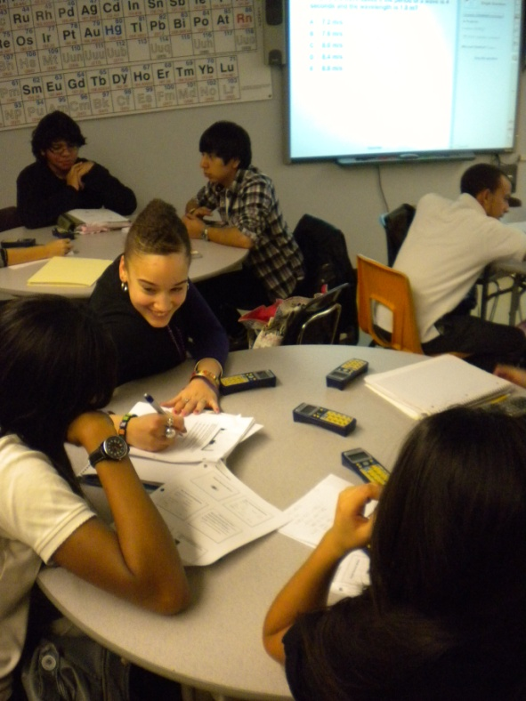
Pedagogy
Social Constructivism
  Round Tables
  Group Problem Solving
  Heterogeneous setting

Slide 20
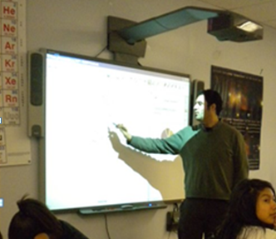
Pedagogy
Direct Instruction
  Interactive White Board (IWB) Notebook presentation
  Student Response Formative Assessment
  Teacher as part of social group

Slide 21
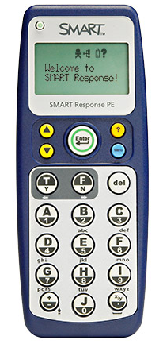
Formative Assessment
Student Responders
Anonymous student polling during class to guide instruction

Slide 22
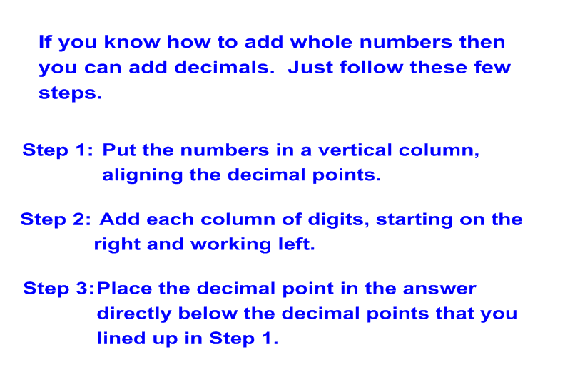
Direct Instruction
Example: Direct Instruction - Adding Decimals

Slide 23
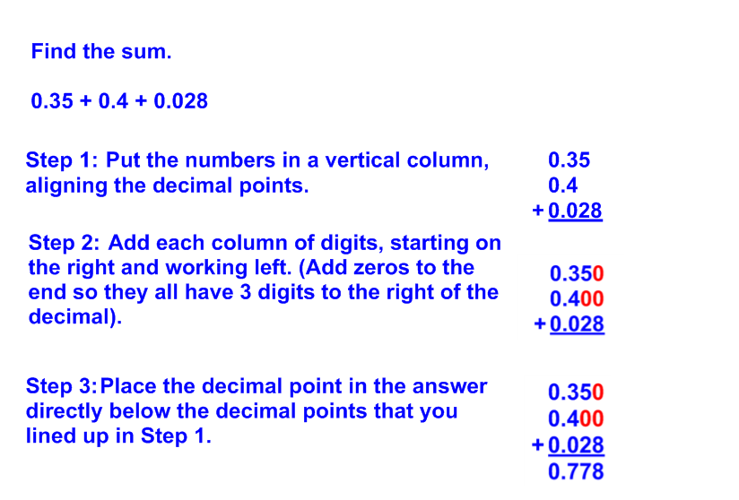
Direct Instruction
Example: Direct Instruction - Adding Decimals

Slide 24
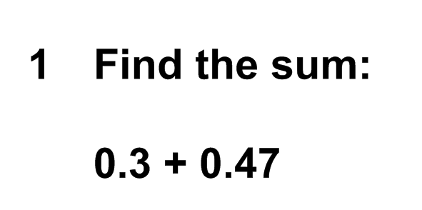
Formative Assessment

Slide 25
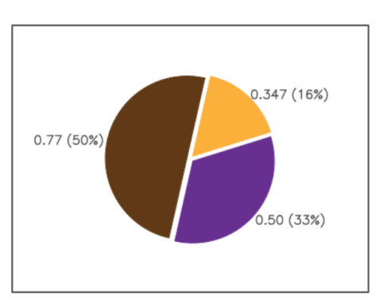
Formative Assessment

Slide 26
Summative Assessment
Grades based only on what students know and can do – Tests, quizzes and labs
Retakes for all assessments
Grades are not subjective
Correlated to End of Course Tests
  (APs, EOC Algebra I, Common Core, etc.)

Slide 27
Implementing Beyond Teterboro
Digital technology makes it possible to share PSI with other schools
Implementing PSI requires physics, chemistry & biology teachers
However, there is a shortage of physics and chemistry teachers

Slide 28
Creating Science Teachers
PSI has shown “all students can learn science”.
We believe “all teachers can learn science”
PSI teaches science to skilled teachers.
The goal is to get the best teachers to become the best science teachers:
“Teaching is hard; science is easy”

Slide 29
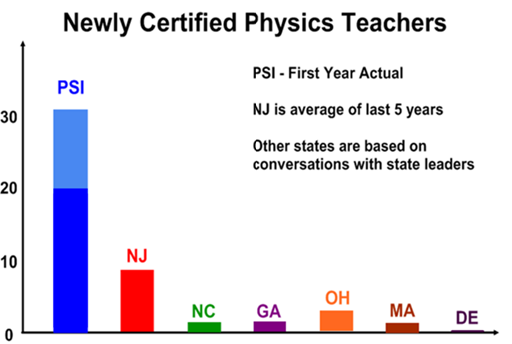
NJCTL Creates Science Teachers
Notes:
Significant continual improvement in quantitative measures: AP exams taken; AP exams passed; state tests passed; and SAT subject test scores
High levels of student interest in science and math based on elective choices and college majors
High student and teacher morale
An ability to “grow its own” great teachers on an ongoing basis along with low turnover of current teachers

Slide 30
New Teachers – June 2011
60 additional teachers – Chemistry and Physics
6 school districts
35 Schools: 21 current + 14 additional
Taught about 4000 students physics or chemistry in 2010-11
Notes:
Significant continual improvement in quantitative measures: AP exams taken; AP exams passed; state tests passed; and SAT subject test scores
High levels of student interest in science and math based on elective choices and college majors
High student and teacher morale
An ability to “grow its own” great teachers on an ongoing basis along with low turnover of current teachers

Slide 31
Newark Physics Teachers
(PSI began in 09-10)

Slide 32
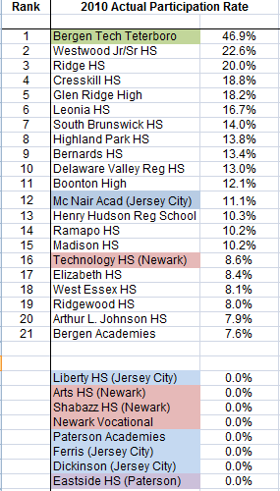
AP Physics B Participation Rates

Slide 33
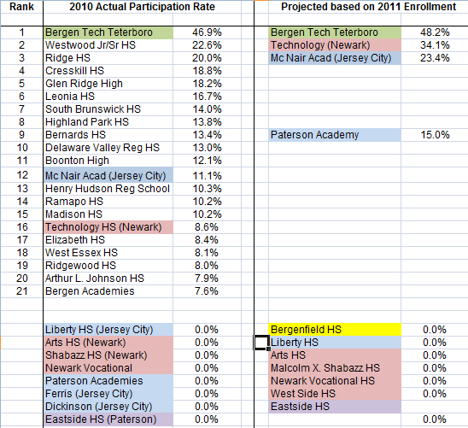
AP Physics B Participation Rates

Slide 34
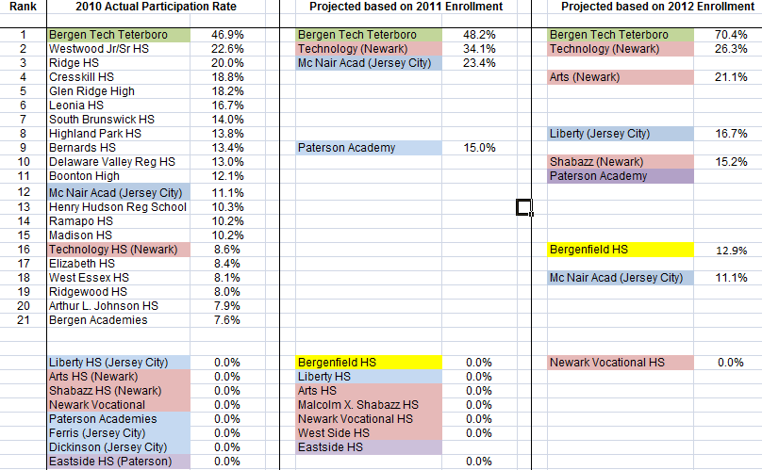
AP Physics B Participation Rates

Slide 35

The Progressive Mathematics Initiative (PMI)

Slide 36
The Progressive Mathematics Initiative (PMI)
PSI methods were first used to develop two courses: Pre-Algebra and Algebra I
Piloted last year with positive results
Now being taught in more than a dozen NJ schools, and being extended to RI and VT

Slide 37
The Progressive Mathematics Initiative (PMI)
High School mathematics almost completed; being piloted now
AP Calculus AB
Pre-Calculus
Algebra II
Geometry
Algebra I

Slide 38
The Progressive Mathematics Initiative (PMI)
Common Core aligned K-8 Mathematics
Being completed in time to be piloted this year
Year long plans and unit plans are posted for each grade

Slide 39
Common Core Mathematics
Common Core adopted by 47 states
Current textbooks are not aligned to Common Core; they need to be replaced
But, textbooks themselves are becoming obsolete; districts don’t want to buy new ones
Free, highly effective, Common Core aligned course materials are critically important

Slide 40
PMI
Common Core Mathematics
PMI has Common Core K-8 courses
Algebra I is currently aligned with the ADP Algebra I assessment
All high school courses will be Common Core aligned for next fall, when they are needed

Slide 41
The Progressive Mathematics Initiative (PMI)
College Algebra piloted at Kean University
Used with students who had failed the course at least once, often multiple times
Better results on common assessments than sections with students who had not previously failed

Slide 42

Learning Forward – National Report

Slide 43
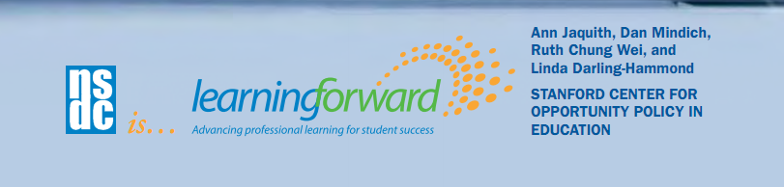
Learning Forward – National Report
“The New Jersey Center for Teaching and Learning (NJCTL) has been doing groundbreaking professional development work in math and science instruction as well…using the innovative curriculum of 2006 New Jersey Teacher of the Year Robert Goodman…to create the Progressive Science Initiative….”

Slide 44

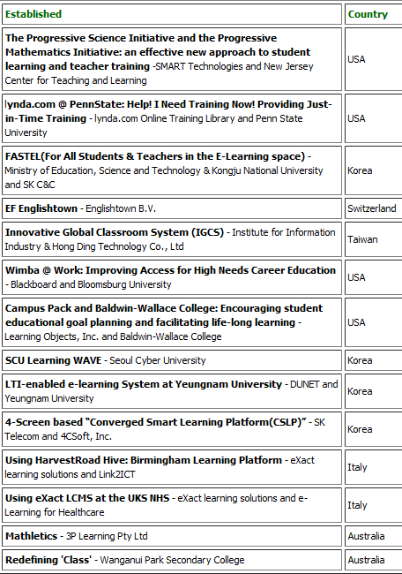

2011 IMS
Learning Impact Award
The Progressive Science Initiative and the Progressive Mathematics Initiative: an effective new approach to student learning and teacher training – SMART Technologies and New Jersey Center for Teaching and Learning

Slide 45

2011 IMS Learning Impact Award

Slide 46
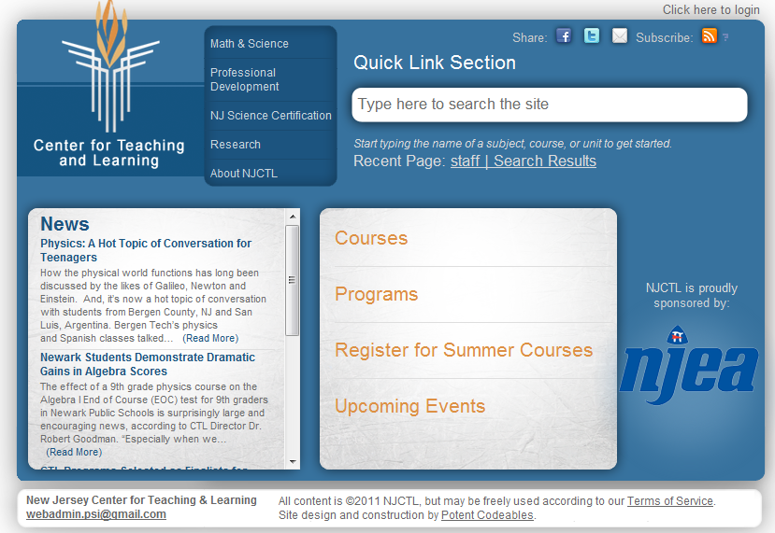
www.njctl.org

Slide 47
Free Digital Course Content
22 Courses Posted
  Most of K-12 Mathematics
  College Algebra
  Most of High School Science

Slide 48
Free Digital Course Content
Everyone can see all the content, but the assessments, at www.njctl.org
Free registration for teachers to get access to all assessments

Slide 49
The Progressive Mathematics Initiative (PMI)
Freely Available Mathematics Courses
Kindergarten Grade 8 (& Algebra)
Grade 1 Algebra I
Grade 2 Geometry
Grade 3 Algebra II
Grade 4 Pre-Calculus
Grade 5 AP Calculus
Grade 6 College Algebra
Grade 7 (& Accelerated)

Slide 50
The Progressive Mathematics Initiative (PMI)
Freely Available Science Courses
Algebra-Based Physics
AP Physics B (trigonometry based)
AP Physics C: Mechanics (calculus based)
AP Physics C: E&M (calculus based)
Chemistry
AP Chemistry
Biology
AP Biology (being completed now)

Slide 51
Free Digital Course Content
About 40,000 slides
  50+ writers
  At 30 second per slide, it would take 300 hours to see them all
Growing rapidly

Slide 52
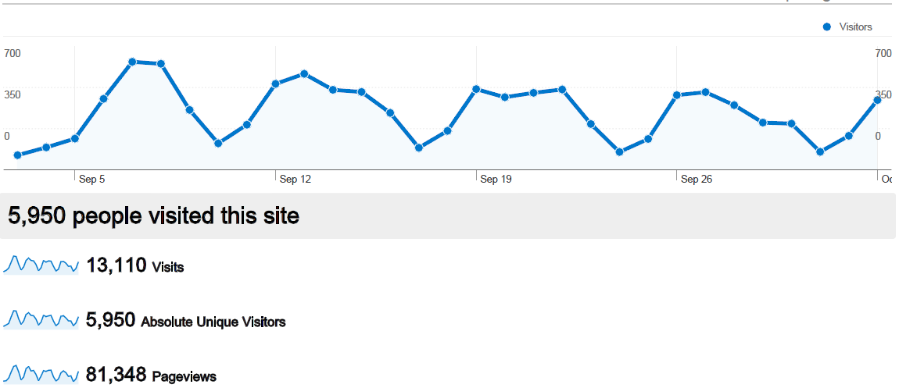
September Web Site Analytics

Slide 53
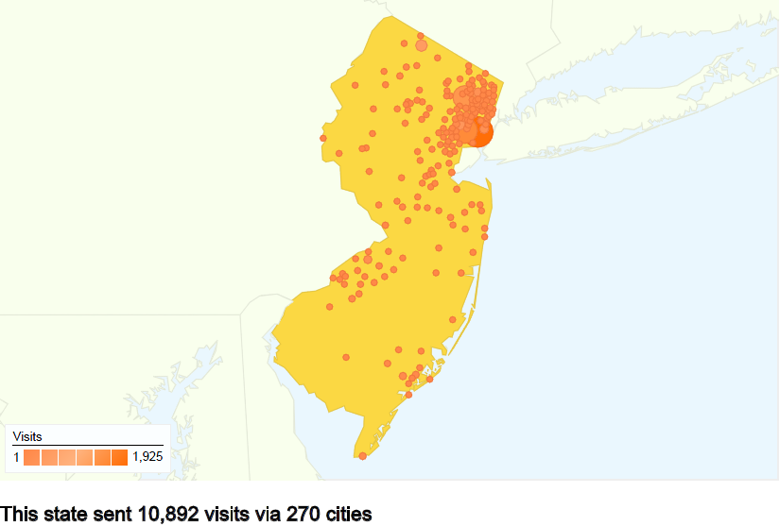
September Web Site Analytics

Slide 54
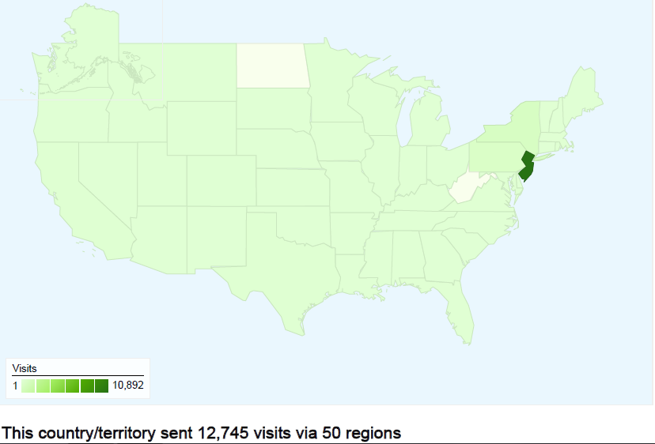
September Web Site Analytics

Slide 55
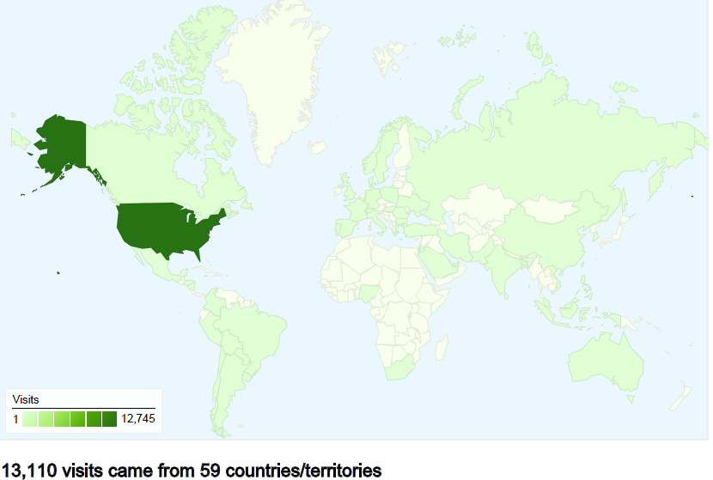
September Web Site Analytics

Slide 56
Students and Teachers
Learning Communities
Now, thousands of students are taking the same courses, this could scale up to hundreds of thousands
Now, hundreds of teachers are teaching the same courses, this could scale up to tens of thousands
This provides a foundation for large scale global collaboration through internet connections

Slide 57
Curriculum Accessibility Project
SMART Notebook
  The only format for current content
  Largest market share of Interactive White Boards
  Software free on our site
PowerPoint
  Easier access for casual visitors
  Accessible on all devices (computers, laptops, tablets, phones, etc.)
  Important for one to one initiatives

Slide 58
Free Self Taught Virtual Courses
PowerPoint with YouTube Hyperlinks
All formative assessment questions answered in video recordings by students
Already completed 450 formative assessment problems, all of Algebra Based Physics

Slide 59
Training Courses
Current Model – Face to Face
Will post online free self-directed training - Owner’s Manual for how to use online course content
Will offer as a Moodle On-line Course, with instructor, for a lower fee than face-to-face

Slide 60
PSI-PMI Paradigm Shift
Arthur Levine, president of the Woodrow Wilson National Fellowship Foundation, describes PSI-PMI in these words:
“There is a shift from teaching to learning, from working alone to collaboration, from passive to active learning, from analog to digital, from teaching a class to sharing authority for educating all the kids at a school, or beyond.”

Slide 61
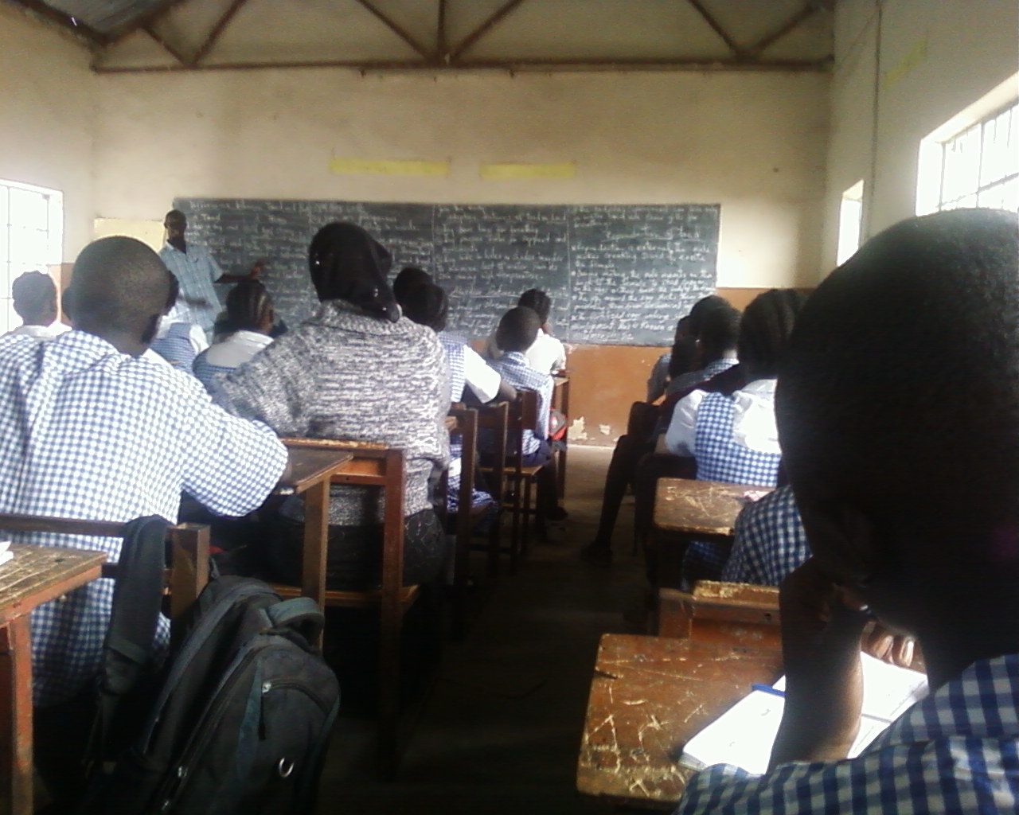
PSI-PMI Paradigm Shift
For what world are we preparing our students?
Isolated work:
factual recall;
sitting quietly;
transcribing;
accepting

Slide 62
PSI-PMI Paradigm Shift
For what world are we preparing our students?
Collaborative work:
critical thinking;
problem solving;
talking;
debating
questioning

Slide 63
PSI-PMI Paradigm Shift
Digital technology has enabled a new paradigm for teaching and learning
There’s no reason to build a new system with the old paradigm.
Build with the new paradigm

Slide 64
New Jersey
Center for Teaching and Learning
Empowering Teachers …Leading Change
www.njctl.org
Notes:
A Foundation created and initially funded by the NJEA in 2006
Its mission is to empower teachers to lead change so that all children have access to a high quality education
One aspect of that mission is to work with teachers to spread and improve successful programs so that all students benefit

