Slide 1
New Jersey
Center for Teaching and Learning
Empowering Teachers …Leading Change
www.njctl.org
Notes:
A Foundation created and initially funded by the NJEA in 2006
Its mission is to empower teachers to lead change so that all children have access to a high quality education
One aspect of that mission is to work with teachers to spread and improve successful programs so that all students benefit

Slide 2
Progressive Science Initiative (PSI) & Progressive Mathematics Initiative (PMI)
PSI developed to teach HS science
PSI then used to create HS science teachers
PMI uses PSI Methods to teach K-12 math
PMI will be used to create K-12 math teachers

Slide 3
Progressive Science Initiative (PSI) & Progressive Mathematics Initiative (PMI)
Developed in 1 NJ school: 1999 - present
Extended to 50+ NJ schools: 2007 – present
Extended to Argentina: 2010 - present
Extended to RI: 2011

Slide 4
PSI-PMI Paradigm Shift
From teaching, to learning

Slide 5
PSI-PMI Paradigm Shift
From teacher-centered, to student-centered

Slide 6
PSI-PMI Paradigm Shift
From passive learning, to active learning

Slide 7
PSI-PMI Paradigm Shift
From teacher isolation, to teacher collaboration

Slide 8
PSI-PMI Paradigm Shift
From schools and classrooms being private and hidden, to being public and visible

Slide 9
PSI-PMI Paradigm Shift
From static analog textbooks, to continuously improving digital content

Slide 10
PSI-PMI Paradigm Shift
From teachers being responsible for only their students, to being responsible for all students

Slide 11
PSI-PMI Paradigm Shift
“There is a shift from teaching to learning, from working alone to collaboration, from passive to active learning, from analog to digital, from teaching a class to sharing authority for educating all the kids at a school, or beyond.”
Arthur Levine, President
Woodrow Wilson National Fellowship Foundation

Slide 12
PSI-PMI Methods
Curriculum
Pedagogy
Formative Assessment
Summative Assessment and Grading
Technology
Face-to-Face and Virtual PLCs

Slide 13
Pedagogy
Social Constructivism
Plus
Direct Instruction

Slide 14
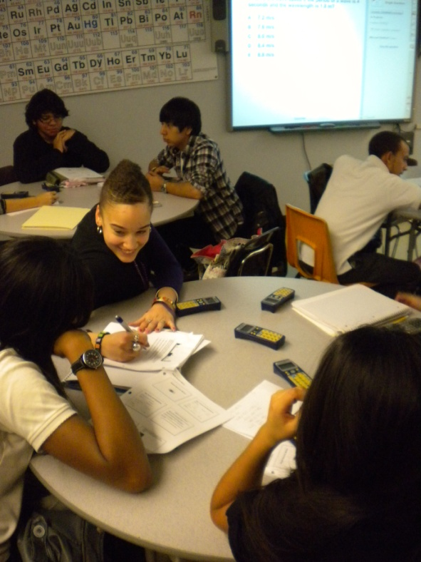
Pedagogy
Social Constructivism
Round Tables
Group Problem Solving
Heterogeneous setting

Slide 15
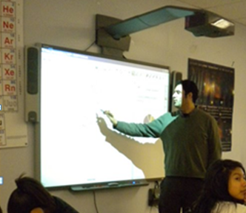
Pedagogy
Direct Instruction
Interactive White Board (IWB) Notebook presentation
Student Response Formative Assessment
Teacher as part of social group

Slide 16
Formative Assessment
Student Responders
Anonymous student polling during class to guide instruction

Slide 17
Direct Instruction
Direct Instruction: Adding Decimals

Slide 18
Direct Instruction
Example: Adding Decimals

Slide 19
Formative Assessment

Slide 20
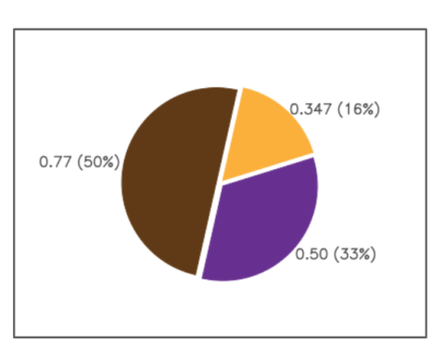
Formative Assessment

Slide 21
Summative Assessment
Grades based only on what students know and can do – Tests, quizzes and labs
Retakes for all assessments
Grades are not subjective
Correlated to End of Course Tests
(APs, EOC Algebra I, Common Core, etc.)

Slide 22
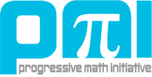
The Progressive Mathematics Initiative (PMI)

Slide 23
The Progressive Mathematics Initiative (PMI)
PSI methods were first used to develop two courses: Pre-Algebra and Algebra I
Piloted last year with positive results
Now being taught in more than a dozen NJ schools, and being extended to RI and VT

Slide 24
Algebra I APD EOC Test Results
Students who took Algebra I course

Slide 25
Algebra I ADP EOC Test Results
Percentage of students in school who took Algebra I

Slide 26
The Progressive Mathematics Initiative (PMI)
College Algebra piloted at Kean University
Used with students who had failed the course at least once, often multiple times
Better results on common assessments than sections with students who had not previously failed

Slide 27
The Progressive Mathematics Initiative (PMI)
High School mathematics almost completed; being piloted now
AP Calculus AB
Pre-Calculus
Algebra II
Geometry
Algebra I

Slide 28
The Progressive Mathematics Initiative (PMI)
Common Core aligned K-8 Mathematics
Being completed in time to be piloted this year
Year long plans and unit plans are posted for each grade
Early part of the year’s content is complete

Slide 29
Common Core Mathematics
Common Core is becoming the standard in 43 states
Current textbooks are not aligned to Common Core; they need to be replaced
But, textbooks themselves are becoming obsolete; districts don’t want to buy new ones
Free, highly effective, Common Core aligned course materials are critically important

Slide 30
PMI Common Core Mathematics
PMI has already launched Common Core K-8 courses
Algebra I is currently aligned with the ADP Algebra I assessment
All high school courses will be Common Core aligned for next fall, when they are needed

Slide 31
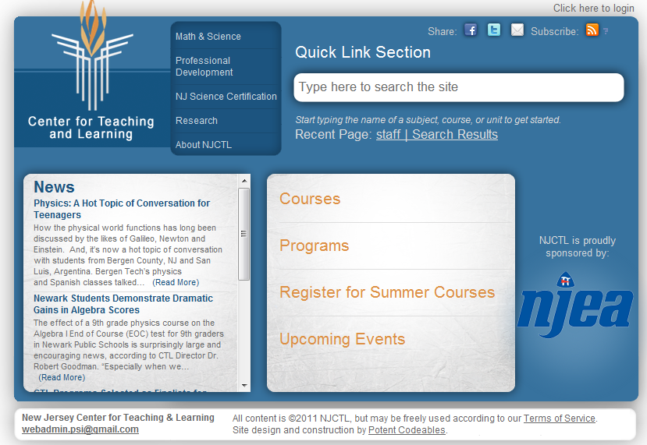
www.njctl.org

Slide 32
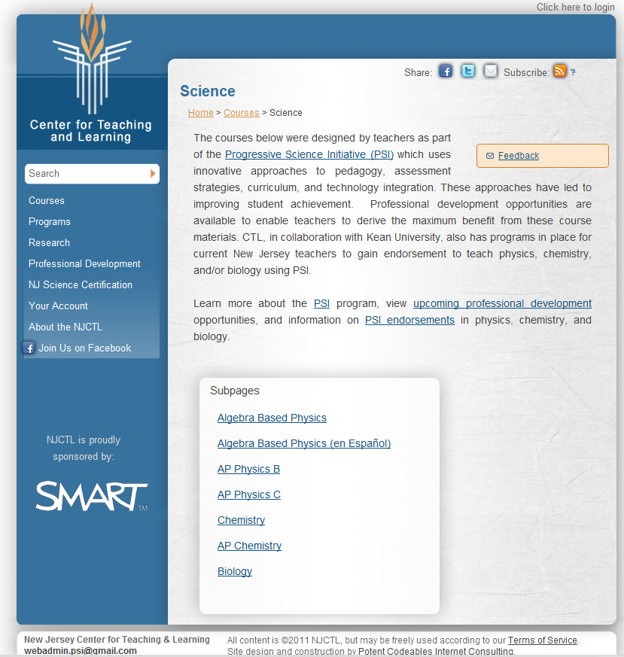
www.njctl.org

Slide 33
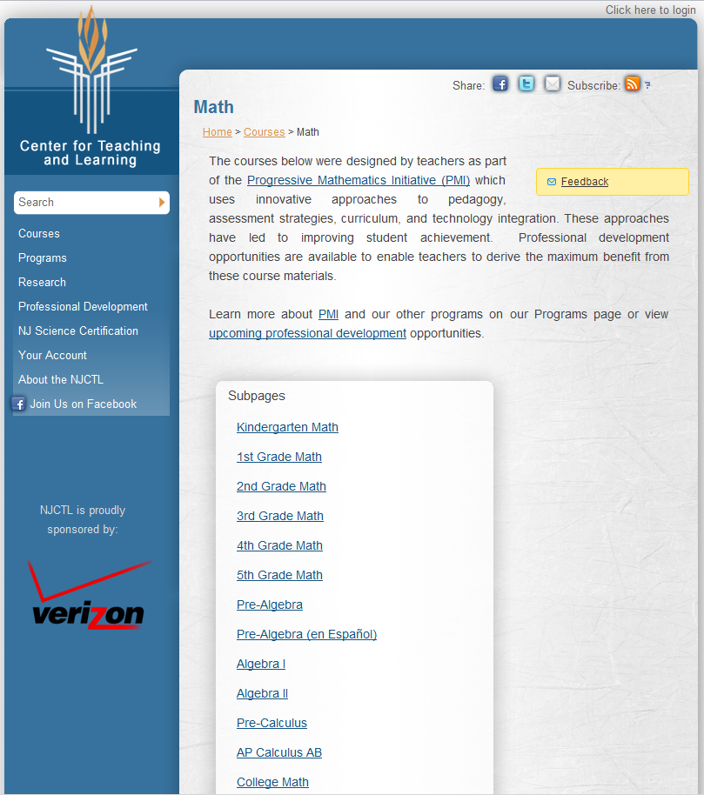
www.njctl.org

Slide 34
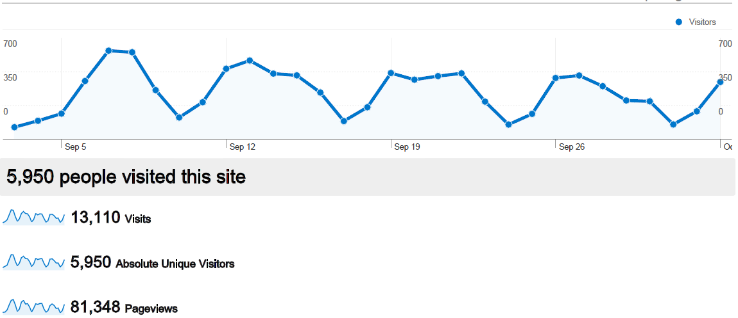
September Web Site Analytics

Slide 35
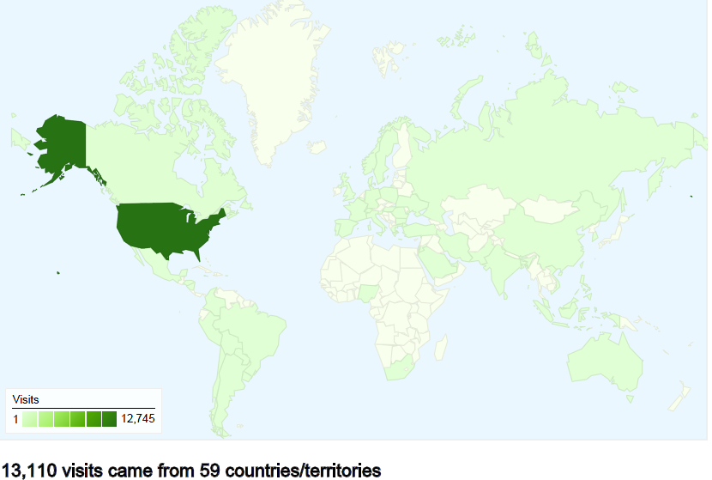
September Web Site Analytics

Slide 36
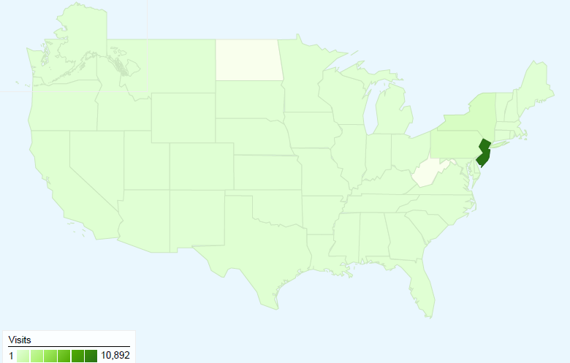
September Web Site Analytics

Slide 37
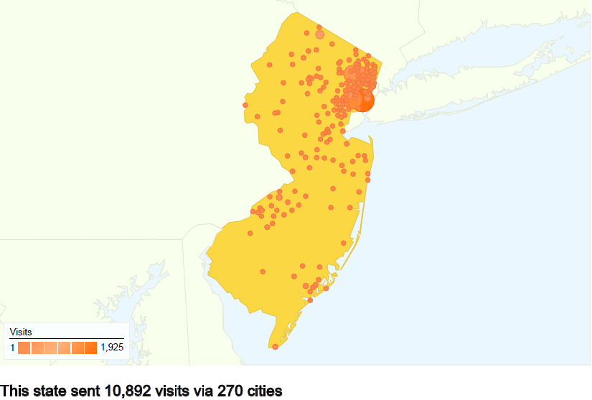
September Web Site Analytics

Slide 38
Students and Teachers Learning Communities
Now, thousands of students are taking the same courses, this could scale up to hundreds of thousands
Now, hundreds of teachers are teaching the same courses, this could scale up to tens of thousands
This provides a foundation for large scale global collaboration through internet connections

Slide 39
New Jersey
Center for Teaching and Learning
Empowering Teachers …Leading Change
www.njctl.org
Notes:
A Foundation created and initially funded by the NJEA in 2006
Its mission is to empower teachers to lead change so that all children have access to a high quality education
One aspect of that mission is to work with teachers to spread and improve successful programs so that all students benefit

